Slide 1
Robot Project 2018/2019 Meeting 1, 31/08/18
Bourgogne, Colrat, Evaux, Gaizi, Nicolle – ACE TEAM

Slide 2
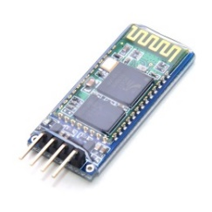
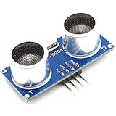
Work Planning
First Step:
Movements: PWM & encoders configuration is working
Adjust Speed, direction, encoders data processing Amine
Communication: Board with Bluetooth Module Virgile
Send instructions to the Board that should understand them
Ultra Sonic Obstacle detection Marlon
Analyze the environment

Slide 3
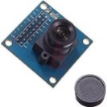
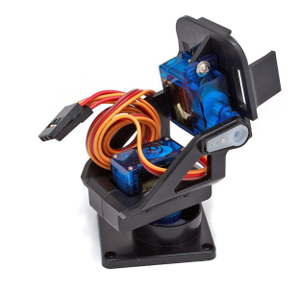
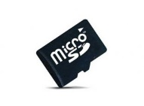
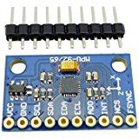
Work Planning
Second Step:
Camera integrated to the robot Maxime
Tough module, takes time to program
Servomotors to change the angle of the camera with PWM
Save pictures in SD Card
Movements enslavement (PID) Virgile
Gyroscope: Amine and/or Marlon
Mapping of the environment’s obstacles with collected data (ultra sonic, camera, gyroscope)

Slide 4
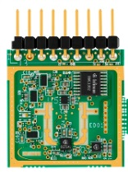
Work Planning
Third Step:
Radar Maxime
Detect objects, its speed and range precisely
Files transfer from the SD card to computer: New mean of communication, which one ? Ex: Xbee (radio module)

Slide 5
Documentation
Code managed through a private Github repository
Clear repartition of the pins and modules used by each module to avoid conflict
Code will be correctly commented
A wiki page (from github for example) to explain how each module, function, library used works, how to build the project and add correctly iLLD’s
Videos to explain how to use the Robot

Slide 6
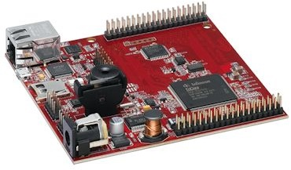
What do we need ?
4 properly working Aurix TC277 D Step
The ones left by the other students do not work properly
Oscilloscope for the lab downstairs
Supply voltage

